Slide 1


Slide 2
Agenda
Introduction
Why use it Hybrid Mobile Application?
Advantage of Hybrid Mobile Application
Disadvantage of Hybrid Mobile Application
Native Vs Hybrid Vs Web Comparison
Apache Cordova Introduction
Create Your First Application
Insert Cordova Plugin in Application
Import Application in Android Studio (Android)

Slide 3
SVG Introduction
SVG stands for Scalable Vector Graphics. It is a feature of HTML5 for describes about 2D Graphics. SVG element is denoted as <SVG>,Which is a container of SVG graphics. For vector representation and for 2 dimensional drawings we use SVG. Since SVG is vector based it can easily handles Scaling.
SVG is mostly useful for vector type diagrams like Pie charts, Two-dimensional graphs in an X,Y coordinate system etc.
SVG became a W3C Recommendation 14

Slide 4

SVG Features
Scalable & SVG Graphics load faster other than Raster Images
Print High Quality at any Resolution
Search, Indexed & Scripted
SVG Pure XML File
Dynamically change Data for Charts

Slide 5
SVG Advantages
It works perfectly with apps tagged with large rendering areas like Google Maps.
SVG images can be created and edited with any text editor.
SVG images are scalable.
SVG images can be printed with high quality at any resolution
SVG images can be searched, indexed, scripted, and compressed.
SVG files are pure XML.
The source file size tends to be smaller, so SVG graphics load faster than their raster counterparts and use less bandwidth.
No Unnecessary HTTP Request.

Slide 6
SVG Disadvantages
SVG is not suited for game applications.
If your application requires support for IE8, remember that you must either provide another vector fallback (such as the more convoluted VML).

Slide 7

SVG Browser Support, Applications & Tools
SVG Applications:-
https://santatracker.google.com/#village
http://hell-o-baby.com/promo
SVG Tools:-
Illustrator
Inkscape
Gimp

Slide 8
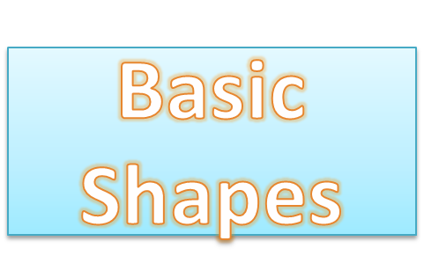
SVG Basic Shapes
Rectangle
Circle
Ellipse
Line
Polyline
Polygon
Path

Slide 9
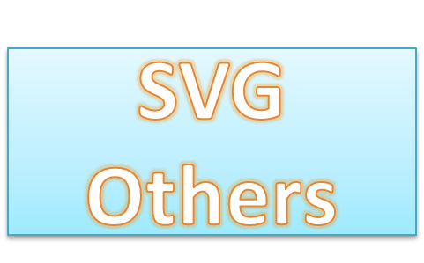
SVG Other Styles
Filters
Gradient
Linear
Radial

Slide 10
Canvas Introduction
The HTML <canvas> element is used to draw graphics, on the fly, via Scripting (usually JavaScript).
The <canvas> element is only a container for graphics. You must use a Script to actually draw the graphics.
The canvas element is an element defined in HTML code using Width and Height attributes
It can be used to draw graphs, make photo compositions or do simple (and not so simple) animations.

Slide 11
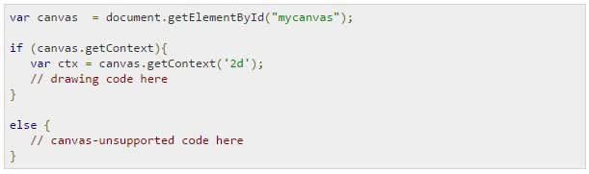
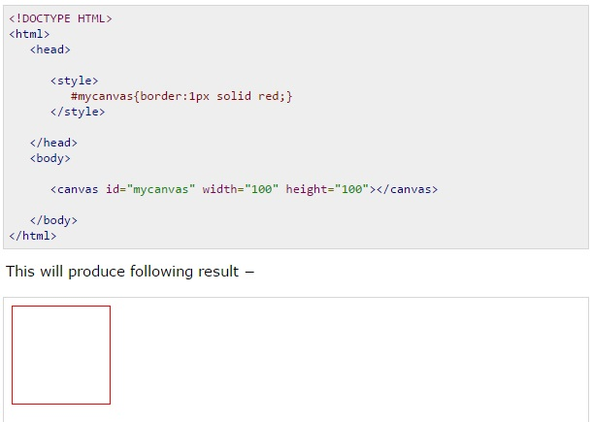
Canvas in HTML5 & JS

Slide 12

Features of Canvas
Interactivity
Animation
Flexibility
Popularity
Web Standard
Draw Text
Browser / Platform Support

Slide 13
Advantages of Canvas
Dynamic graphics
Online and offline games
Animations
Fast Rendering
Lot of Flexibility

Slide 14
Disadvantages of Canvas
It is Complex
It can be slow when drawing to large area.
It’s not supporting in IE9 below version.

Slide 15
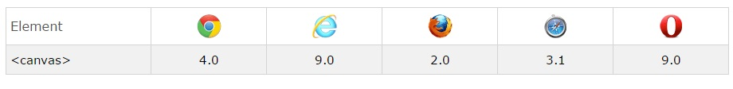
HTML5 Canvas Browser Support

Slide 16

HTML5 Canvas Elements
Text
Images
Lines
Curves
Paths
Shapes
Fill Styles
Transformations

